Slide 1
Submitted By Name: Deepthi A Reg.No: 962821205019 Dept: Information Technology
Skin Disease Detection using Deep Learning with ResNet50

Slide 2
PROJECT TITLE
Skin Disease Detection Using Deep Learning with ResNet50

Slide 3


AGENDA
Problem Statement
Project Overview
End Users
Solutions and Proposition
Key Features
Modelling
Results
3/21/2024 Annual Review

Slide 4

PROBLEM STATEMENT
Manual diagnosis of skin diseases by dermatologists is time-consuming and subjective, leading to delays in treatment and potential misdiagnosis.
Develop a deep learning model utilizing ResNet50 architecture to automatically classify skin disease images, aiding in rapid and accurate diagnosis.

Slide 5

PROJECT OVERVIEW
Objective: Develop an automated system using deep learning to classify skin diseases from images.
Methodology: Utilize ResNet50 architecture to train a model on a dataset of skin lesion images, then evaluate its performance.
Expected Impact: Improve dermatological diagnosis by providing a fast, accurate, and accessible tool, potentially reducing healthcare disparities.

Slide 6
WHO ARE THE END USERS?
Dermatologists
Primary Care Physicians
Patients
Healthcare Professionals

Slide 7

SOLUTION
Develop an automated skin disease classification system using deep learning algorithms trained on a diverse dataset of skin disease images.
Deploy the developed system to assist dermatologists in rapid and accurate diagnosis, reducing treatment delays and minimizing the risk of misdiagnosis.

Slide 8
Proposition
Develop an automated system for skin disease diagnosis using machine learning.
Curate a diverse dataset of skin disease images for training and validation.
Design and fine-tune machine learning algorithms for accurate diagnosis.
Integrate the system into clinical workflows to aid dermatologists.
Continuously monitor and improve the system's performance over time.

Slide 9

THE WOW IN YOUR SOLUTION
The project's wow factor is that by automating skin disease diagnosis with machine learning, we're revolutionizing healthcare, ensuring quicker and more accurate treatment for patients while supporting dermatologists with advanced technology.
3/21/2024 Annual Review
9

Slide 10
MODELLING
Data Collection and Preparation:
Assemble a diverse dataset of skin disease images with accurate annotations.
Standardize image size, color, and orientation, and augment the dataset for increased diversity and model robustness.
Model Development and Training:
Utilize ResNet50 architecture as the base model for its proven effectiveness in image classification tasks.
Customize the model by adding relevant layers and fine-tune its parameters to optimize performance on the skin disease classification task.
Evaluation and Deployment :
Train the model on the prepared dataset, monitoring key metrics such as accuracy and loss.
Evaluate the trained model's performance on a separate test set to ensure generalization and deploy it as an automated system for rapid and accurate skin disease diagnosis.
10

Slide 11
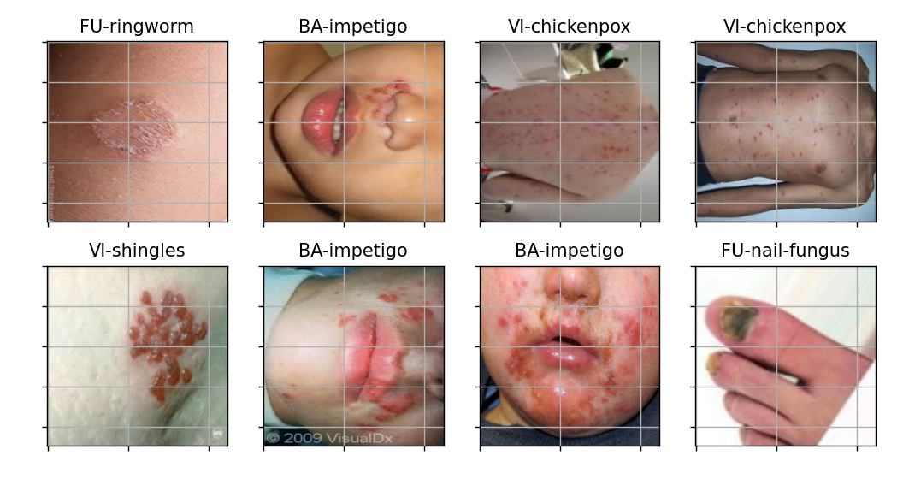
RESULTS
11

